Slide 1


Slide 2
New Training Framework
Retains same high-quality Entry/Standard level training (past VTF)
Expanded to include Advanced Skills training to respond to:
    Demand for higher skills from employers
    More sectors needing new higher qualifications
    Job changers and upskilling current staff a growing area
    Need to explore other models and expand service offer
Advanced/Higher Level
    Up to 16-week course
    Roles around £30-35k
    Higher level qualifications/awards
    More focused on individuals working so flexible delivery

Slide 3
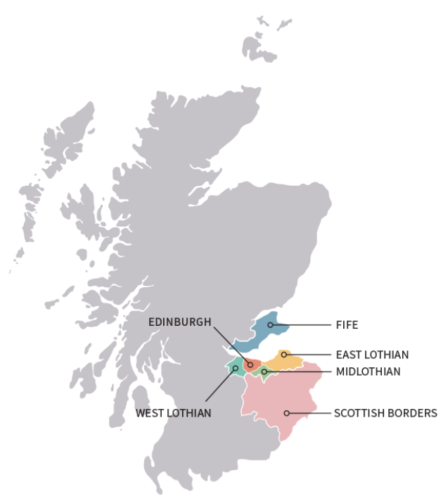
Regional Coverage
Can cover all Local Authorities but primarily focused on Edinburgh
Any Local Employability Partnership (LEP) stakeholder and City Region Deal IRES partners can use JobFit to support their employability outcomes.

Slide 4
JobFit Framework
Standard Level
Higher Level
Hospitality
Health and Social Care
Early Learning and Childcare
Manufacturing
Construction
Creative Industries
Finance
Retail
Miscellaneous
Construction/Net Zero/Retrofit
Tourism, Hospitality and Culture
Advanced Health and Social Care
Creative Industries
Land and Rural Skills
Miscellaneous
AI and Data Skills
Advanced Manufacturing, Engineering and Robotics

Slide 5
Process
Co-Design
Joint agreement on sector focus, course requirements and qualifications
Sessions based around skills required by business
Employers sourced using JUFB/JobFit/IRES networks
Referral (DWP, SDS, DYW, Employability Provisions etc)
Job Coaches/Employability/Link Workers/Employers share course details and begin referrals and carry out first assessment (eligibility and criteria)
JobFit conducts second assessment against course criteria (RTW/age etc as requested by employers)
JobFit manages enrolment of successful clients in collaboration with selected training provider
Delivery
Every course includes industry certs and/or accredited qualifications and employability support
Insight session from participating employer/s
Guaranteed interview for all participants
Outcomes
JobFit coordinates employer interviews/progresions - results fed back to referring organisations
Clients starting work signposted to in-work support
Ongoing sustainment checks at 1, 4, 8, 13 and 26 weeks
Unsuccessful learners are linked into wider employer opportunities and signposted for ongoing guidance and support

Slide 6
Outcomes
921 completed training (92% completion rate)
50.5% people moved into jobs
83% overall progression rate (jobs, further education or volunteering)
70% job sustainment rate at 6 months
80% learners stated the course increased confidence in job searching
“We have been able to tap into a market of quality, well trained candidates and save significant amounts of money which we can now re-invest into business development and improvement.”
Daniel – Care Support Scotland, April 25
“ JobFit have worked closely with us during recruitment (inviting us in to speak with all candidates about careers and giving us an opportunity to interview individuals) …We work collaboratively together and regularly take on feedback from each other.” Elizabeth, Manager, Daddy Daycare Edinburgh, April 26

Slide 7
Make it with
E: trainingacademy@capitalcitypartnership.org
https://jobfit.careers/

