Slide 1

Joined Up for Jobs Forum – 26th February 2026

Slide 2




Joined Up for Business – Project Updates
FORTY funding ceased - no more course delivery through FKRSC currently
FORT Programme - expanded delivery model in the pipeline, including enhanced employer and community engagement strategies.
Numerous part-time roles at Fort Kinnaird - team can support with opportunities
CCP managed service – Stage 4 and 5
Increase in hospitality and managerial vacancies
All vacancies in SJQ now directed through FUSE website and linked to Helix
Upcoming Health & Social Care course – March
Expanding framework to include Advanced Skills from April 2026
MacMillan Skills hub comes to an end as UKSPF concludes at end March 2026
New clients signposted to Edinburgh Guarantee

Slide 3


Community Job Fairs
Held quarterly across the city in community spaces
Recruiting employers and providers involved to remove barriers to work and employability support
Jobseekers register in advance to enable follow-up with job, training and additional support opportunities
Upcoming fairs advertised on the Joined Up for Business and LEP website
Next job fair planned for end May with FUSE in city centre, focusing on retail, hospitality and tourism roles

Slide 4


Upcoming Events
High Impact Recruitment Event – 9th March at EICC
Joint DWP and LEP event
Focus on Young People 16-24
Book slot through Eventbrite
Allocated times for younger clients 16-19 and quiet hour available.
Attendees book slots through Eventbrite
https://tinyurl.com/yf4hebnr

Slide 5


Slide 6
Background
No One Left Behind funding created the Vocational Training Framework
Focus on entry level jobs across entry level sectors
2–4-week courses designed with the employer
Built confidence and delivered qualifications
Guaranteed job interview
921 completed training (90% completion rate)
50% people moved into jobs
75% overall progression rate (jobs, further education or volunteering)

Slide 7
Need for Change
Expanded to include Advanced Skills training to respond to:
Demand for higher skills from employers
More sectors needing new higher qualifications
Job changers and upskilling current staff a growing area
Need to explore other models and expand service offer
Skills Bootcamps in England successful for £30-35k jobs
Up to 16-week course
Higher level qualifications
More focused on individuals working so flexible delivery
Procurement in final stages - new framework live from April 2026

Slide 8
New JobFit Framework
Entry Level
Higher Level
Hospitality
Health and Social Care
Early Learning and Childcare
Manufacturing
Construction
Creative Industries
Finance
Retail
Miscellaneous
Construction/Net Zero/Retrofit
Tourism, Hospitality and Culture
Advanced Health and Social Care
Creative Industries
Land and Rural Skills
Miscellaneous
AI and Data Skills
Advanced Manufacturing, Engineering and Robotics

Slide 9
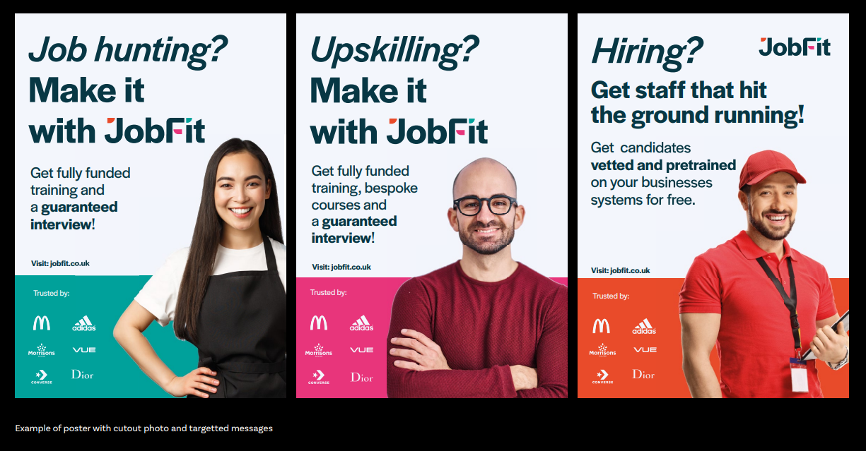
Launch Project April 2026
New framework and website
Any LEP stakeholders can use JobFit and City Region Deal IRES partners
Referral routes and contact details remain the same

Slide 10
Make it with
E: trainingacademy@capitalcitypartnership.org

Slide 11
joinedupforbusiness@capitalcitypartnership.org
www.joinedupforbusiness.org

