Slide 1
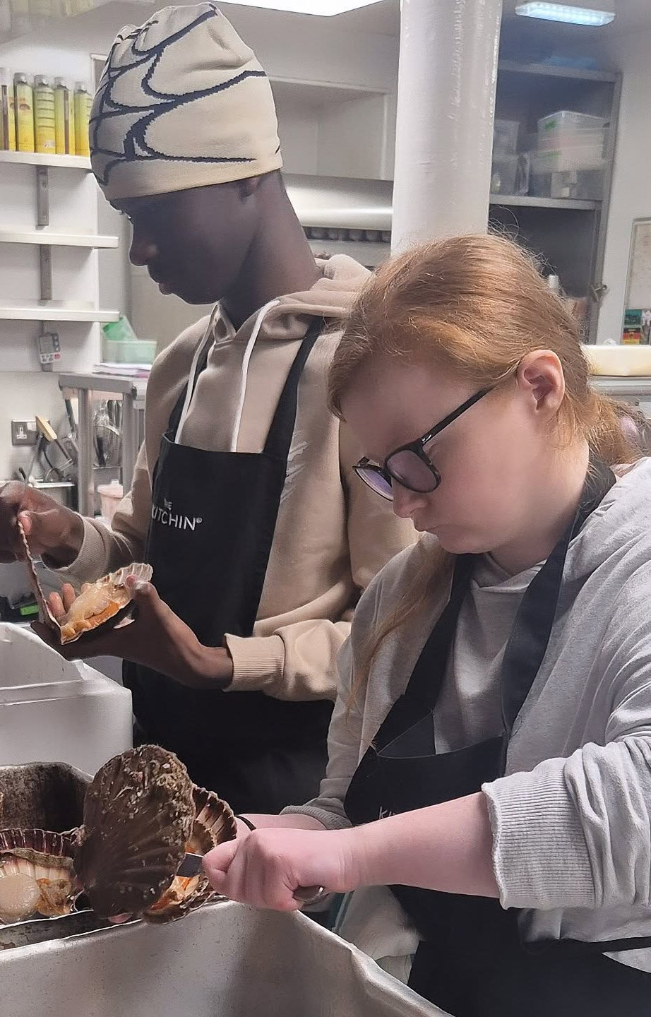


Employer Engagement in Action

Slide 2
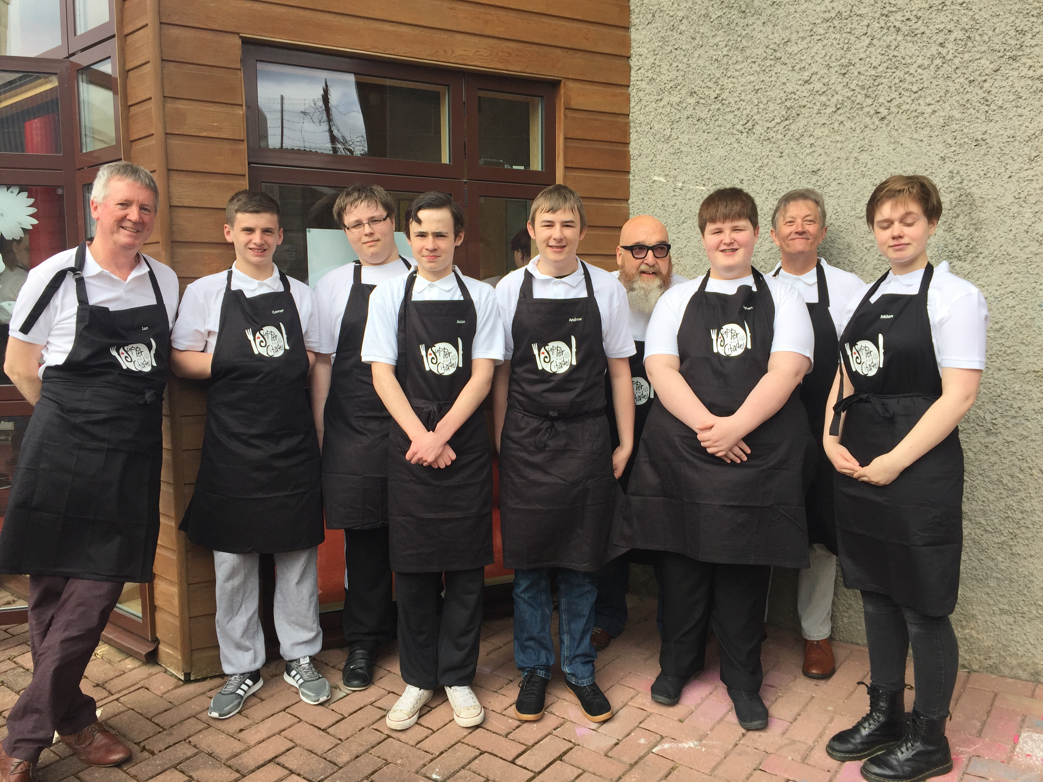
Started in 2016
With 6 young people working in The Kitchin, served at The Citadel with 64 guests.

Slide 3
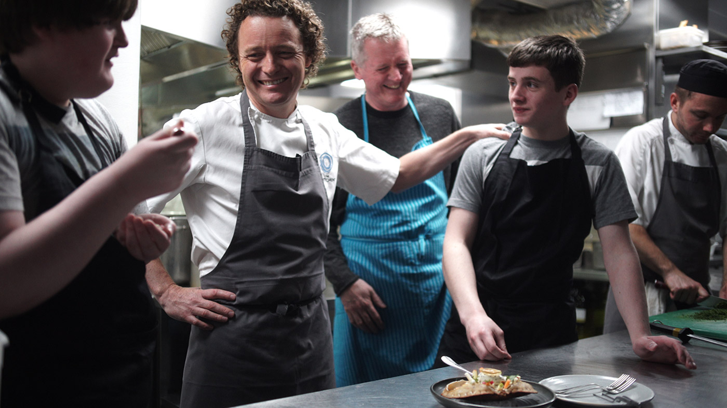
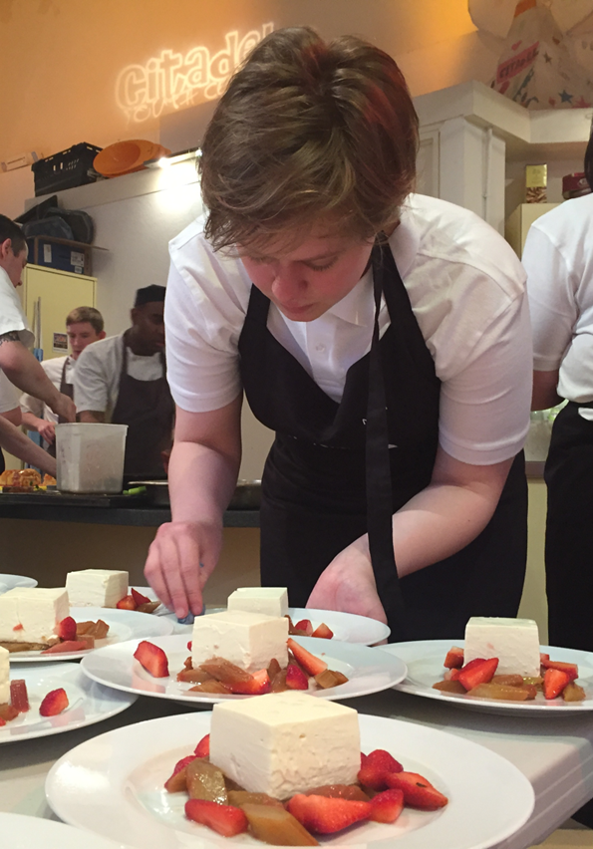
“That one day in your kitchen taught me more than any textbook ever could. Great cooking isn’t about impressing others, it’s about making someone feel seen with every bite”

Slide 4
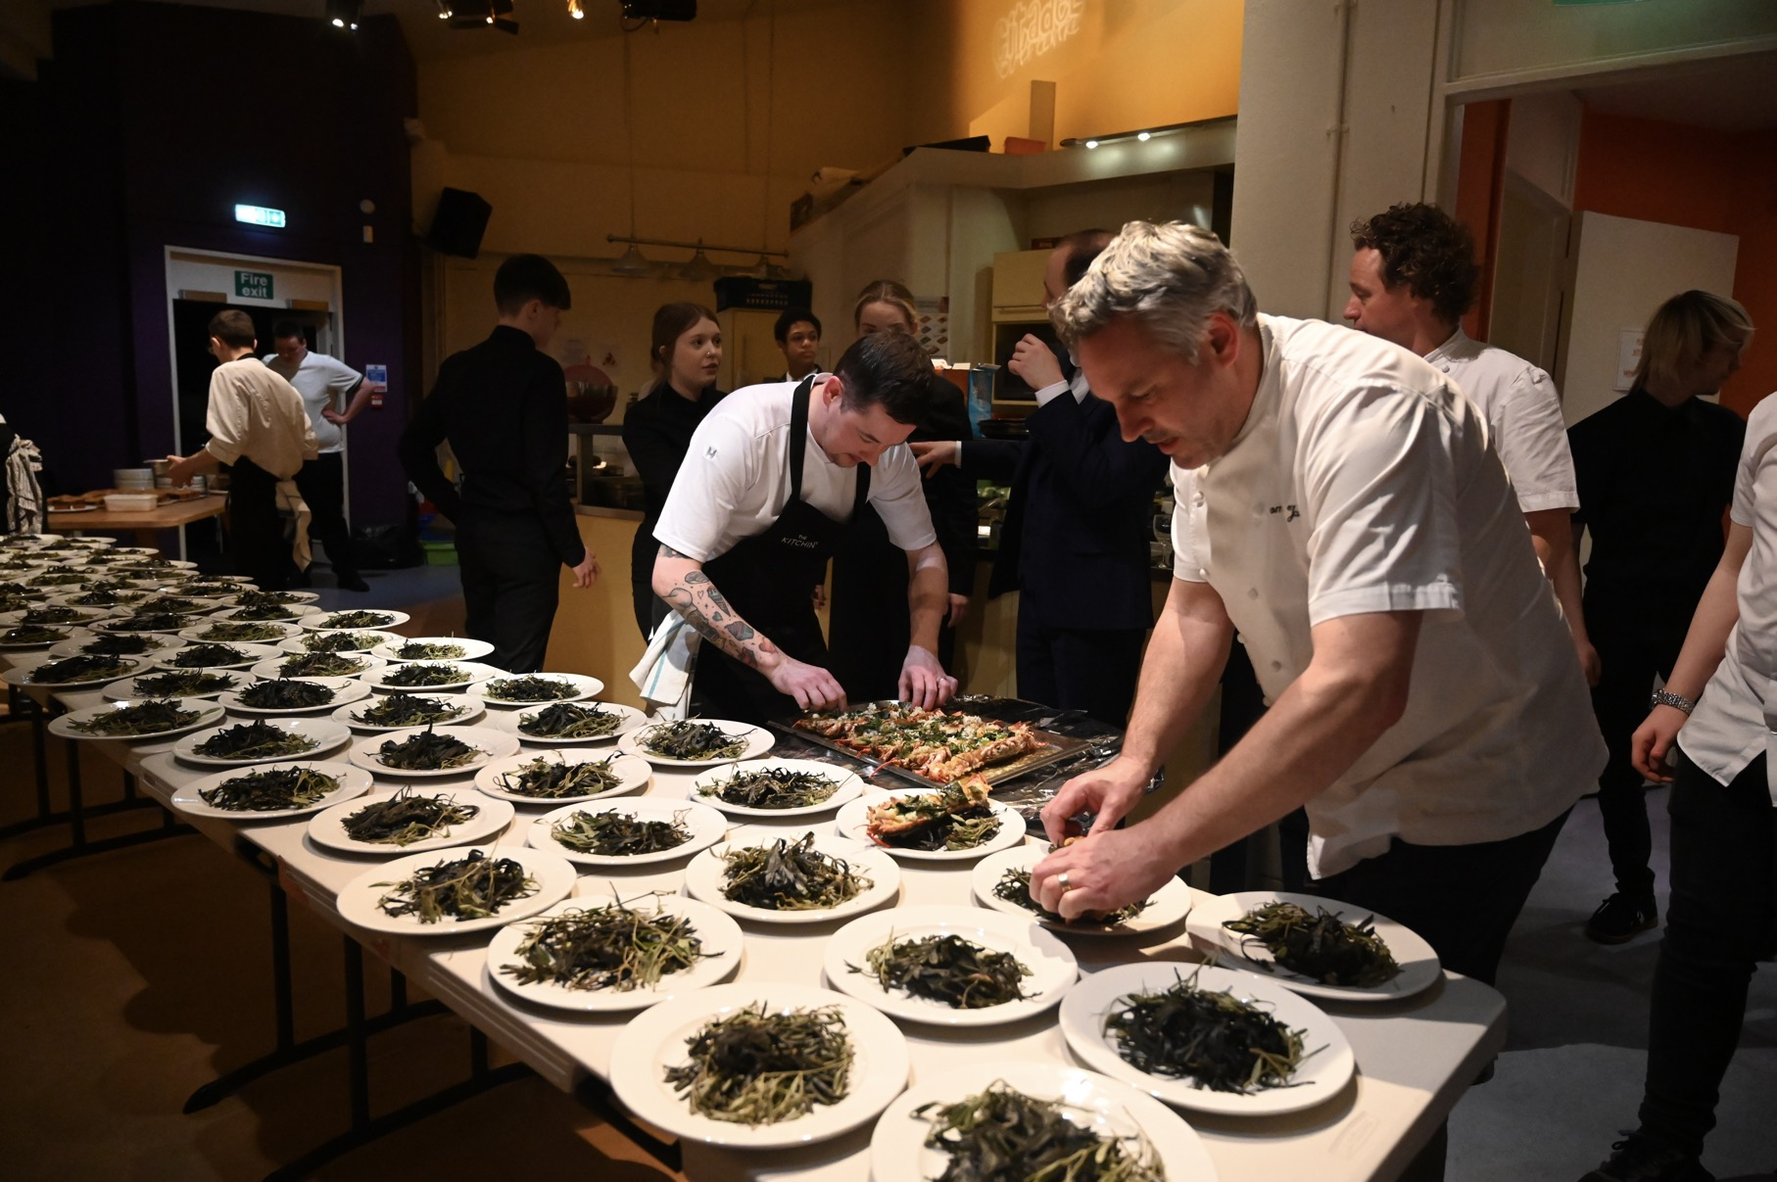
Supper At The Citadel 2019 & 2024
Notes:
In 2019,

Slide 5
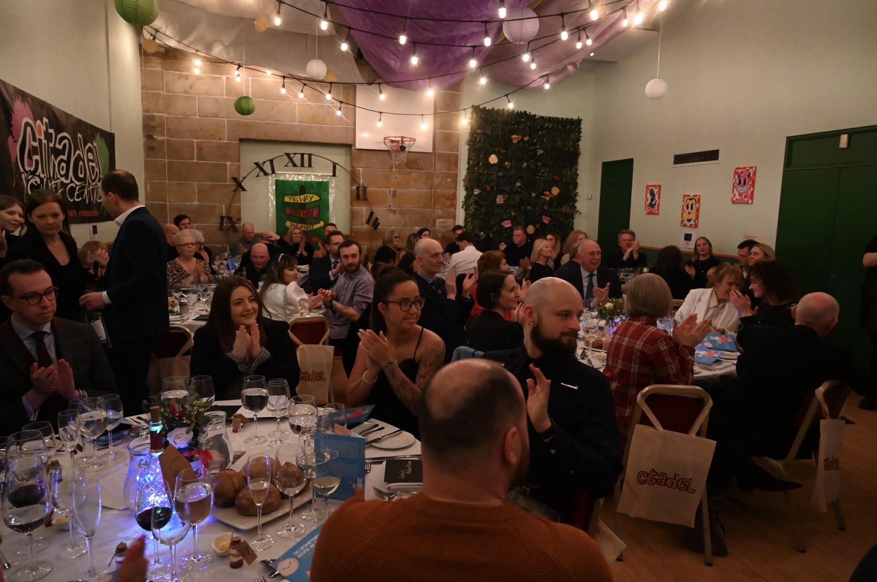
Supper At The Citadel 2019 & 2024
Notes:
In 2019,

Slide 6
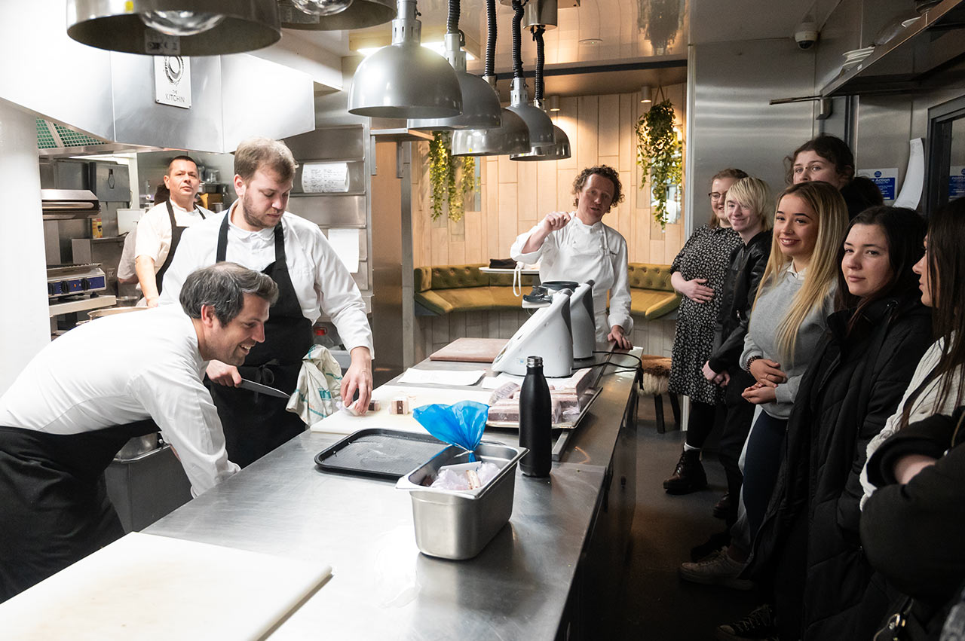
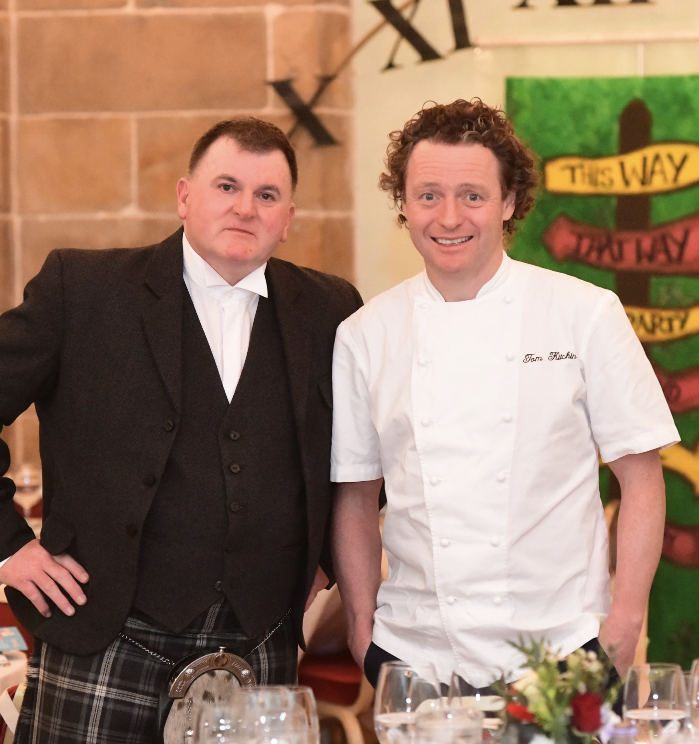

Slide 7
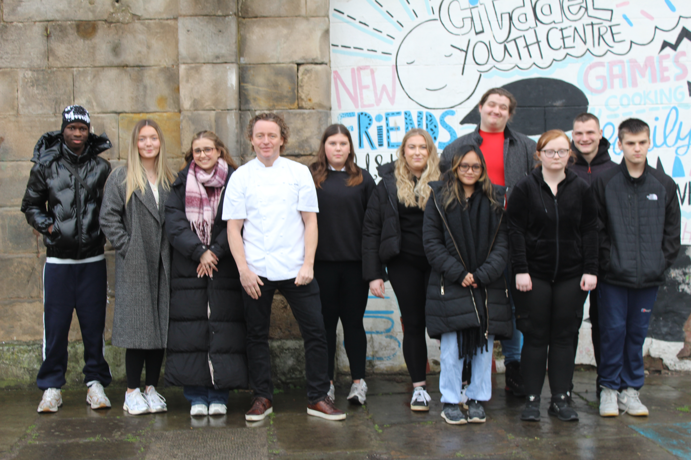


Lunch at The Kitchin
Biggest year yet, lunch held at the Michelin Star Restaurant, The Kitchin, in conjunction with Mission Christmas.

